Slide 1
Disparity between West Pakistan and East Pakistan

Slide 2
1947, Pakistan created in two parts, West and East
Separate areas, deep differences in language, religion, culture
Government policies, spending favored West, East remained poor
1971, East Pakistan declared independence
Pakistani government responded with armed force
Liberation war followed; thousands of people died

Slide 3
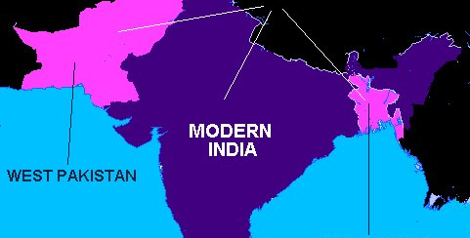
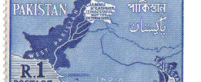
2 regions of Pakistan after independence - West and East

Slide 4
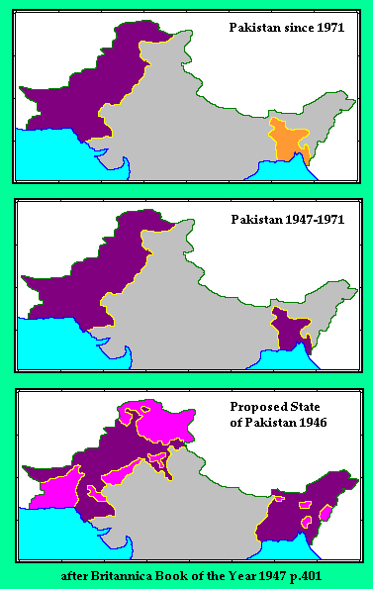
Over 1,000 miles between the 2 regions
Muslim, but different cultures
The West area dominated the political ways of the country.
Split into Pakistan & Bangladesh 1971

Slide 5
Causes of War
They were separated by nearly 1,600 km of Indian land, spoke different languages (Urdu in the West, Bangla in the East) and had different cultural histories.
As the capital city was in West Pakistan, the East thought that the country was being unfairly ruled.
Finally, the government declared that 'Urdu and only Urdu' would be the national language of all Pakistan.
This was a language that virtually no one in East Pakistan spoke.

Slide 6
Social Background
Many discriminations were reportedly existing East and West Pakistan on the societal level:
Most of the high administrative positions were occupied by the West Pakistanis:
Source: Govt. Report of 1958 (Bangladesh Studies: MOU)
Huge discrimination was prevailing in the area of education facility:
West Pakistan | East Pakistan | Total | Posts
19 | 0 | 19 | Secretary
38 | 03 | 41 | Joint Secretary
130 | 03 | 133 | Deputy Secretary
138 | 58 | 196 | Foreign Ambassadors
510 | 38 | 548 | Section Officer
West Pakistan | East Pakistan | Grade
04 | 02 | University
04 | 01 | Medical College
5244 | 2217 | Primary School

Slide 7
Social Background
Disparity was also there in case of employment. Most of the high posts were held by them and the minimal jobs were also distributed unevenly among the general population. Look at the following table:
West Pakistan | East Pakistan | Type of Job | Year
326 | 186 | Civil Service of Pakistan | 1967-68
141 | 86 | Pakistan Tax Service
76 | 40 | Customs & Service
36 | 20 | Railway Accounts Service
95 | 44 | Audit & Accounts
50 | 18 | Military Accounts
128 | 82 | Police Service of Pakistan
49 | 19 | Central Information
Source: Budget Discussion in the National Assembly of Pakistan, June 18, 1968

Slide 8
Economic Background
1) Population Comparison:
Throughout the history of Pakistan, the province of East Bengal had a greater population than all the other provinces of Pakistan combined, as the following table shows:
2) But economically the East was exploited by the West Pakistani ruling elite:
East Bengal was the world's largest producer of raw jute (a fiber), which was Pakistan's main foreign exchange earner. The foreign trade statistics in its first decade for Pakistan were as follows:
Population in Millions |  |  | Province
1971 | 1961 | 1951
70 | 50.8 | 41.9 | East Pakistan
60 | 42.9 | 33.7 | West Pakistan
West Pakistan |  | East Pakistan |  | 5 years period
Imports | Exports | Imports | Exports
4769 | 3786 | 2129 | 4582 | 1947-52
5105 | 3440 | 2159 | 3969 | 1952-57

Slide 9
Economic Background
West Pakistan had four provinces: Punjab, Sindh, Balochistan, and the North-West Frontier. The fifth province was East Pakistan.
Having control over the provinces, the West used up more resources than the
East.
Between 1948 and 1960, East Pakistan made 70% of all of Pakistan's exports, while it only received 25% of imported money.
In 1948, East Pakistan had 11 fabric mills while the West had nine.
In 1971, the number of fabric mills in the West grew to 150 while the number in
the East went down to 26.
About 2.6 billion dollars of resources were also shifted over time from East Pakistan to West Pakistan.

Slide 10
The Pakistani Army
The leader of the Pakistani army was also the self-appointed president of Pakistan.
General Agha Mohammed Yahya Khan planned a genocide attack on East Pakistan against Bengali elite and the Hindus of the East.
During the war, they had killed over a million people and had created over 10 million refugees who had fled to India during the war.

Slide 11
1970 Cyclone
A devastating cyclone hit East Pakistan in 1970.
It was called the Bhola Cyclone.
It killed about 500,000 people and made many more homeless.
It brought great shock and deep depression among the East Pakistani people.
But, the government did not provide enough relief to alleviate the extremely miserable conditions wrought by the cyclone.
This caused enormous misery in East Pakistan.

Slide 12
What Actions Led To The War Breaking Out
Although the East had most of Pakistan's population, the Western population, especially the Punjabis, had all of the political power.
In 1970, the East won an election by landslide victory, but the West refused to let the East have power.
This outraged the East, and they believed that independence was necessary.

Slide 13
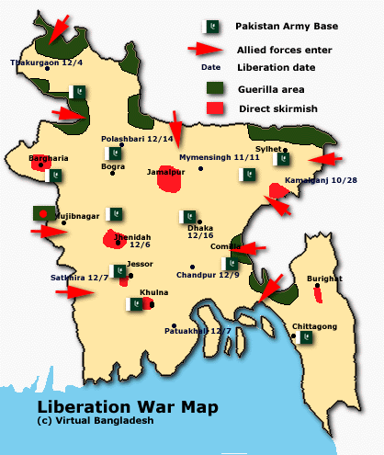
Basics Of The War
Armed Conflict between West Pakistan (now Pakistan) and East Pakistan (now Bangladesh)
Lasted about 9 months – March 26, 1971 until December 16, 1971
India declared war on West Pakistan after the Pakistani air force (PAF) struck Indian airfields in northern India
The war ended 2 weeks later when India and the East had overpowered the West
Resulted in Bangladesh's independence from Pakistan

Slide 14
The Guinness Book of Records lists the Bangladesh Genocide as one of the top 5 genocides in the 20th century.

Slide 15
It all started with Operation Searchlight, a planned military pacification carried out by the Pakistan Army started on 25 March, 1971 to curb the Bengali nationalist movement by taking control of the major cities on March 26, and then eliminating all opposition, political or military, within one month.
Before the beginning of the operation, all foreign journalists were systematically deported from Bangladesh.
The main phase of Operation Searchlight ended with the fall of the last major town in Bengali hands in mid May.
According to New York Times (3/28/71) 10,000 people were killed; New York Times (3/29/71) 5,000-7,000 people were killed in Dhaka; The Sydney Morning Herald (3/29/71) 10,000 – 100,000 were killed; New York Times (4/1/71) 35,000 were killed in Dhaka during operation searchlight.

Slide 16
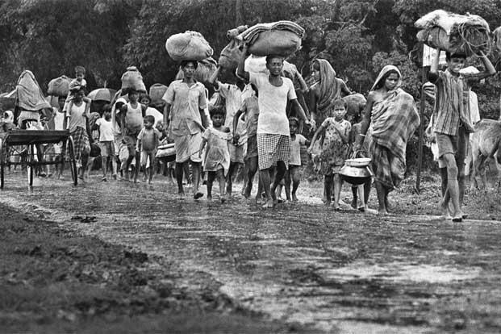

Slide 17
There is no doubt that the mass killing in Bangladesh was among the most carefully and centrally planned of modern genocides.
A cabal of five Pakistani generals orchestrated the events:
President Yahya Khan,
General Tikka Khan, chief of staff
General Pirzada, security chief
General Umar Khan,
Intelligence chief General Akbar Khan.

Slide 18


Slide 19
The genocide and gendercidal atrocities were also perpetrated by lower-ranking officers and ordinary soldiers.
These “willing executioners” were fueled by an abiding anti-Bengali racism, especially against the Hindu minority.
“Bengalis were often compared with monkeys and chickens. Said Pakistan General Niazi, ‘It was a low lying land of low lying people.’ The Hindus among the Bengalis were as Jews to the Nazis: scum and vermin that [should] best be exterminated. As to the Moslem Bengalis, they were to live only on the sufferance of the soldiers: any infraction, any suspicion cast on them, any need for reprisal, could mean their death. And the soldiers were free to kill at will. The journalist Dan Coggin quoted one Punjabi captain as telling him, ‘We can kill anyone for anything. We are accountable to no one.’ This is the arrogance of Power.” (Rummel, Death By Government, p. 335.)

Slide 20
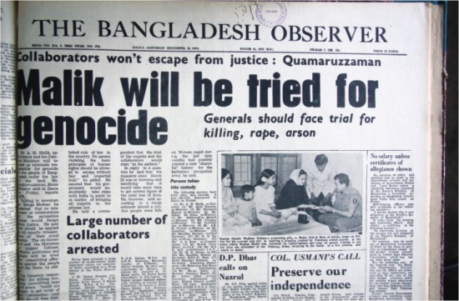

Slide 21
“For month after month in all the regions of East Pakistan the massacres went on,” writes Robert Payne. “They were not the small casual killings of young officers who wanted to demonstrate their efficiency, but organized massacres conducted by sophisticated staff officers, who knew exactly what they were doing. Muslim soldiers, sent out to kill Muslim peasants, went about their work mechanically and efficiently, until killing defenseless people became a habit like smoking cigarettes or drinking wine. … Not since Hitler invaded Russia had there been so vast a massacre.” (Payne, Massacre, p. 29.)

Slide 22
On March 25 the genocide was launched.
The university in Dacca (Dhaka) was attacked and students exterminated in their hundreds. Death squads roamed the streets of Dacca, killing some 7,000 people in a single night.
It was only the beginning. “Within a week, half the population of Dacca had fled, and at least 30,000 people had been killed. Chittagong, too, had lost half its population.
All over East Pakistan people were taking flight, and it was estimated that in April some thirty million people [!] were wandering helplessly across East Pakistan to escape the grasp of the military.” (Payne, Massacre, p. 48.)
Ten million refugees fled to India, overwhelming that country’s resources and spurring the eventual Indian military intervention. (The population of Bangladesh/East Pakistan at the outbreak of the genocide was about 75 million.)

Slide 23
Atrocities Committed
Genocide against the Bengali population of East Pakistan
Minorities of Bangladesh especially Hindus were targets for the Pakistan army
2-400,000 East Pakistani women raped, tortured and killed
Pakistan Army carried out execution of Bengali intellectuals (university professors, etc.)

Slide 24
Atrocities Continued
Most extreme cases of this carried out days before the war ended, when over 200 intellectuals were killed
Unknown how many civilians killed, ranges from 26,000 up to 3 million (most likely around 3 million killed)
The leader of the army, Kahn, stated that they would “Kill three million of them, and the rest will eat out of our hands”

Slide 25
Bangladeshi authorities claim that 3 million people were killed, while the Hamoodur Rahman Commission, an official Pakistan Government investigation, put the figure as low as 26,000 civilian casualties.
The fact is that the number of dead in Bangladesh in 1971 was almost certainly well into seven figures.
It was one of the worst genocides of the World War II era, outstripping Rwanda (800,000 killed) and probably surpassing even Indonesia (1 million to 1.5 million killed in 1965-66).

Slide 26
As R.J. Rummel writes:
“ The human death toll over only 267 days was incredible. Just to give for five out of the eighteen districts some incomplete statistics published in Bangladesh newspapers or by an Inquiry Committee, the Pakistani army killed 100,000 Bengalis in Dacca, 150,000 in Khulna, 75,000 in Jessore, 95,000 in Comilla, and 100,000 in Chittagong. For eighteen districts the total is 1,247,000 killed. This was an incomplete toll, and to this day no one really knows the final toll. Some estimates of the democide [Rummel’s “death by government”] are much lower — one is of 300,000 dead — but most range from 1 million to 3 million. … The Pakistani army and allied paramilitary groups killed about one out of every sixty-one people in Pakistan overall; one out of every twenty-five Bengalis, Hindus, and others in East Pakistan. If the rate of killing for all of Pakistan is annualized over the years the Yahya martial law regime was in power (March 1969 to December 1971), then this one regime was more lethal than that of the Soviet Union, China under the communists, or Japan under the military (even through World War II). (Rummel, Death By Government, p. 331.)”

Slide 27
Bangladesh and Pakistan
Troubles in Bangladesh
Instability in Pakistan
One of poorest, most densely populated countries in the world
Only a few feet above sea level, devastating floods, storms often sweep across country, killing many, leading to widespread famine
Series of governments since independence
Now trying to build stable democracy
Pakistan has also faced instability since war
Ethnic, religious conflicts common
Disagreements about role of Islam in government
Many leaders have taken power; some elected, some through military coups

